Slide 1
Mechanisms and Sensors for Robotic Fingers
Shant Gananian, Pascal Weiner and Tamim Asfour
Seminar: Humanoide Roboter, WS 2018/19

Slide 2
Contents
Introduction
Key issues
1. Number of Fingers
2. Shape of the Fingertips
3. Compliant Joints
2. Built-in or Remote Actuation
3. Transmission
4. Sensors
5. Materials and Manufacturing
Future Trends
Conclusion
References

Slide 3
Introduction
The human hand as an inspiration
Goals and application
Making a anthropomorphic hand (anthropomorphic approach)
Making an efficient manipulator (minimalistic approach)
Key issues discussed here
Number of Fingers
Shape of the Fingertips
Compliant Joints
Built-in or Remote Actuation
Transmission System (in case of remote actuation)
Sensors
Materials and Manufacturing

Slide 4
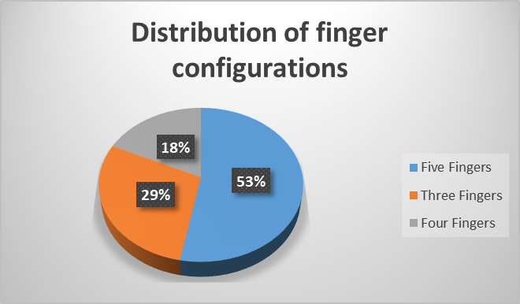
Number of Fingers
* Daniel R. et al. (2017) From 3 fingers to 5 fingers dexterous hands, Advanced Robotics

Slide 5
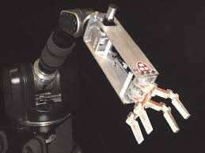
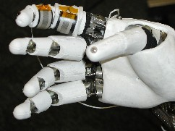
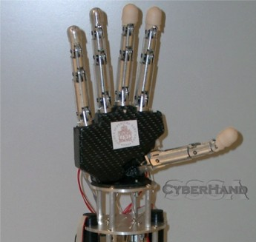
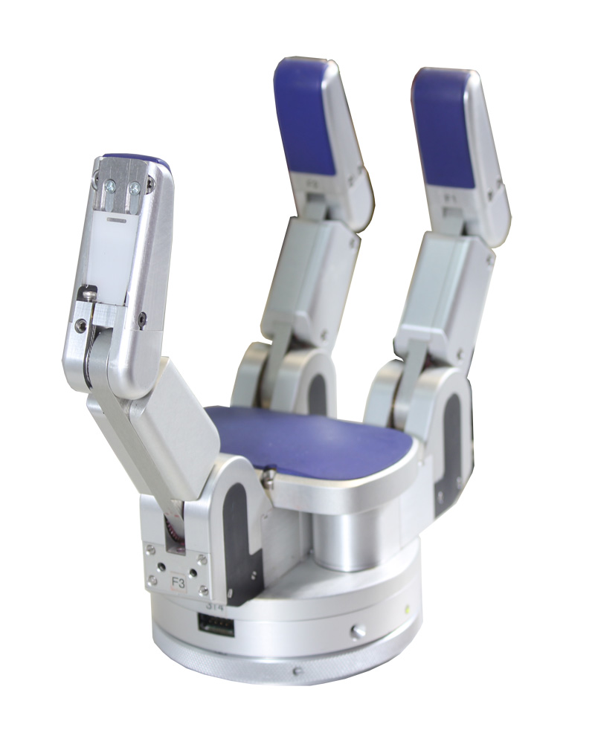
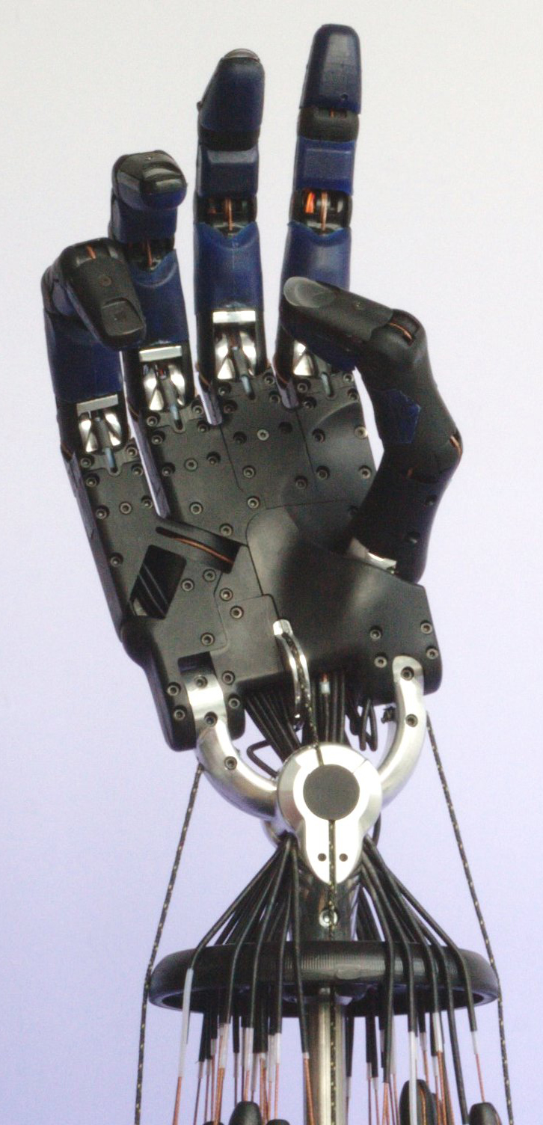
Shape of the Fingertips
Flat
Anthropomorphic
Cylindrical
SDM Hand
Robonaut Hand
CyberHand
Barrett Hand
Shadow Dextrous Hand

Slide 6
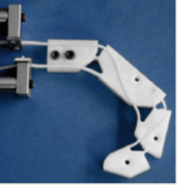
Compliant Joints
reduce overall complexity
withstanding large impacts without damage
Rapid Prototyping
Limited range of motion
Axis Drif
Stress Concentration
The finger is obtained in a single teflon piece
joint compliance is achieved with metallic springs
Rapid prototyping allows for different compliant mechanisms as joints

Slide 7
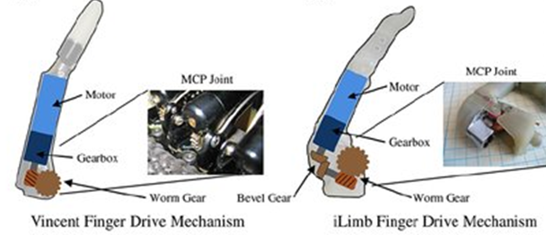
Built-in or Remote Actuation
Built-in Actuation:
Simplifying mechanical configuration of the joint
Reducing the transmission chain complexity
Joint motion is kinematically independent with respect to other joints
Motors occupy a large room inside the finger structure

Slide 8
Transmission
Flexible Link Transmission
pulley-routed flexible elements (tendons, chains, belts)
sheath-routed flexible elements (mainly tendon-like elements)
Actuators located remotely from joints
Achieving two-way control requires a pair (increased complexity)
Rigid Link Transmission
best stiffness proprieties to the transmission
low maintenance
bidirectional control of the joint

Slide 9
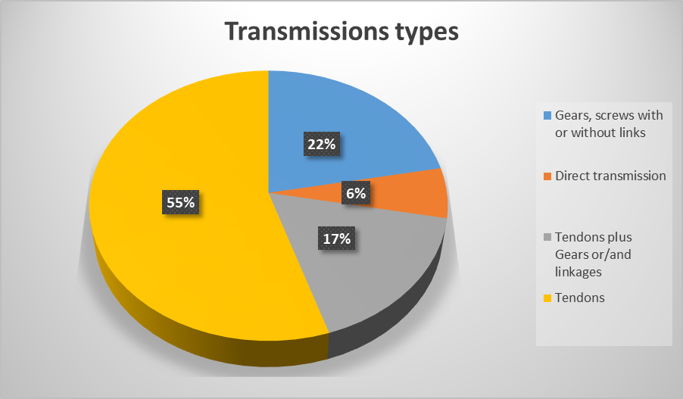
Transmission

Slide 10
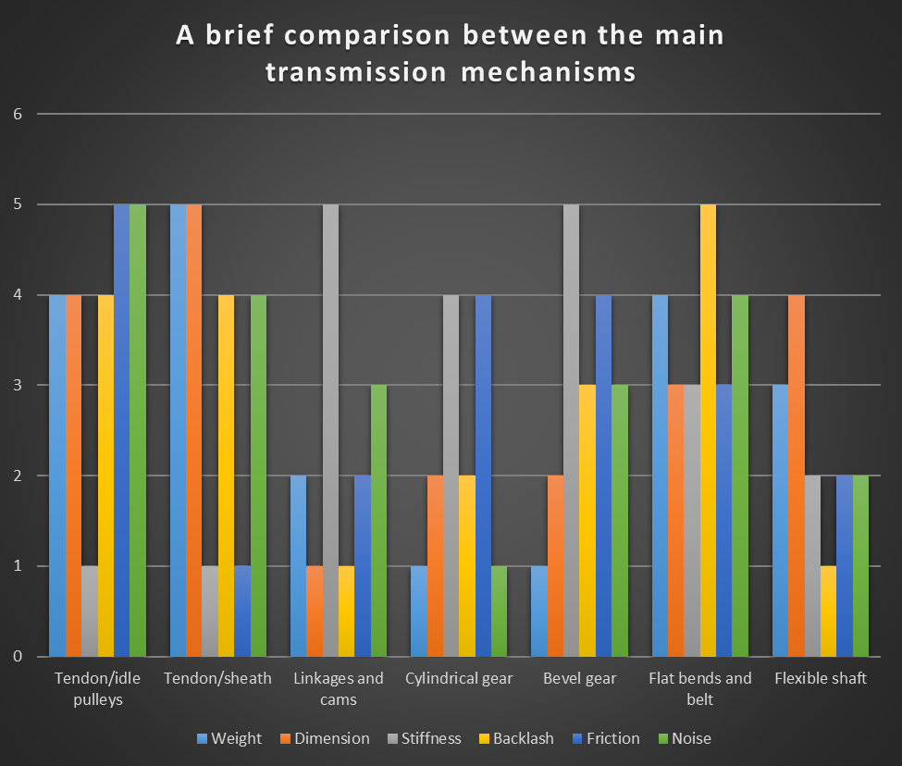
Transmission

Slide 11
Sensors
Proprioceptive Sensors
Measures physical information related to the state of the device itself (e.g., position, velocity, and so on)
Exteroceptive Sensors
Measures the data related to the interaction with objects/environment (e.g., applied forces/torques, friction, shape, and so on)
Tactile Sensors
It provides information about forces of interaction and surface properties at points of contact between the robot fingers and the objects.
The types of information that may be obtained from a tactile sensor are: Contact, force, simple geometrical information, main geometrical features of the object, mechanical properties and slip condition

Slide 12
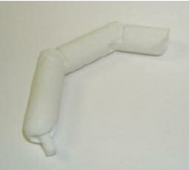
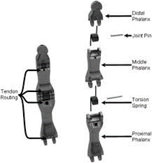
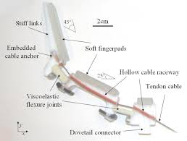
Materials and Manufacturing
Traditional machinery techniques is a rather long and expensive process
Rapid prototyping techniques provides several advantages
The chance to develop parts with complex geometry
Selective Laser Sintering (SLS)
high-strength, nickel-coated thermoplastic
polymer-based Shape Deposition Manufacturing (SDM)

Slide 13
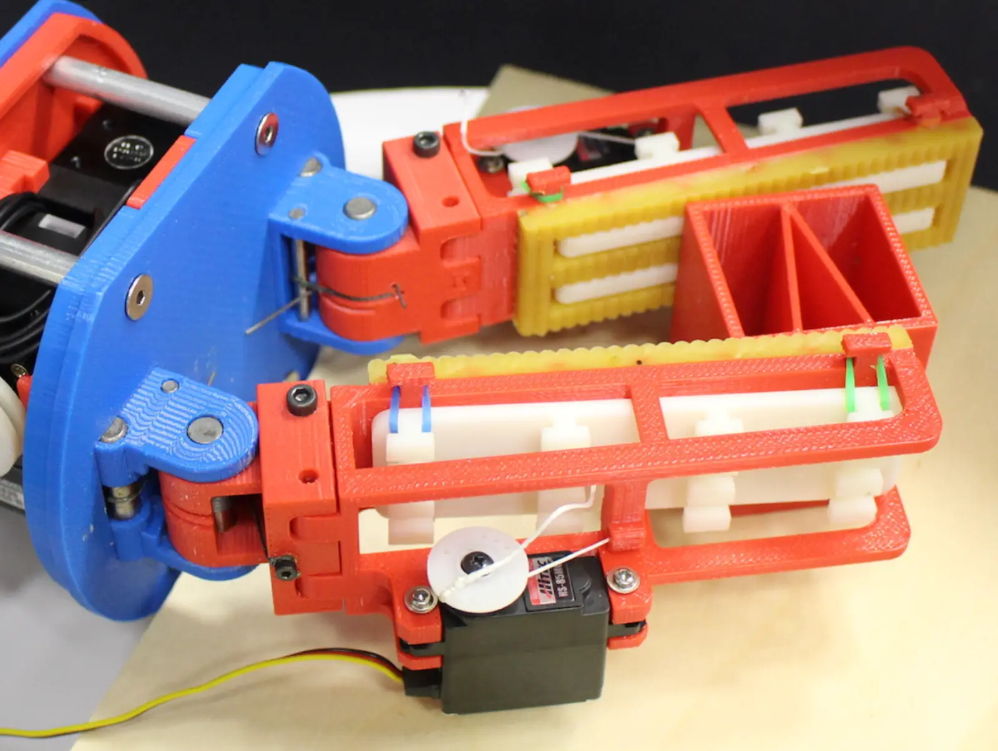
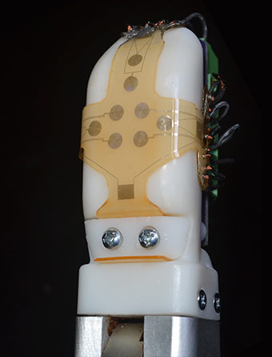
Future Trends
Development of artificial skins with denser spatial resolution and a multitude of sensor modalities.
Using soft and compliant materials like when the hand is used to interact with humans
Robotic finger with both high and low friction surfaces
Bio-inspired sensor skin

Slide 14
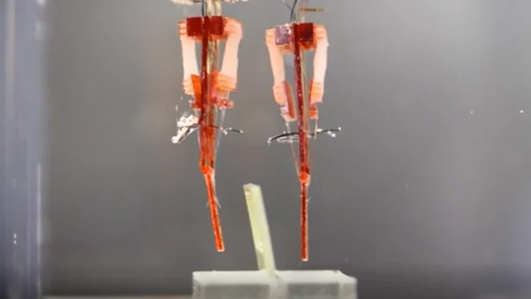
Future Trends
Sensors employed in smartphones will be employed by the artificial hands driving costs down and increasing reliability
Biohybrid robotics
Standardization
Integrating living muscle tissue into robots

Slide 15
Conclusion
The human hand as an inspiration
The crucial role of robot fingers
Key Issues in choosing suitable configurations
Standarization

Slide 16
References
1. Saudabayev, A. and Varol, H.A., 2015. Sensors for robotic hands: A survey of state of the art. IEEE Access, 3, pp.1765-1782.
2. Balasubramanian, R. and Santos, V.J. eds., 2014. The human hand as an inspiration for robot hand development (Vol. 95). Springer.
3. Daniel R. Ramírez Rebollo, Pedro Ponce & Arturo Molina (2017) From 3 fingers to 5 fingers dexterous hands, Advanced Robotics, 31:19-20, 1051-1070
4. Gama Melo, E.N., Aviles Sanchez, O.F. and Amaya Hurtado, D., 2014. Anthropomorphic robotic hands: a review. Ingeniería y Desarrollo, 32(2), pp.279-313.
5. Bos, H.D. and Wassink, M., 2010. Evolution of robotic hand. University of Twente.
6. Alba, D., Armada, M. and Ponticelli, R., 2005. An introductory revision to humanoid robot hands. In Climbing and walking robots (pp. 701-712). Springer, Berlin, Heidelberg.
7. Belter, J.T., Segil, J.L., Dollar, A.M. and Weir, R.F., 2013. Mechanical design and performance specifications of anthropomorphic prosthetic hands: a review. Journal of Rehabilitation Research & Development, 50(5), pp.599-618.
8. Siciliano, B. and Khatib, O. eds., 2016. Springer handbook of robotics. Springer.
9. Spiers, A.J., Calli, B. and Dollar, A.M., 2018. Variable-Friction Finger Surfaces to Enable Within-Hand Manipulation via Gripping and Sliding. IEEE Robotics and Automation Letters, 3(4), pp.4116-4123.
10. Morimoto, Y., Onoe, H. and Takeuchi, S., 2018. Biohybrid robot powered by an antagonistic pair of skeletal muscle tissues. Science Robotics, 3(18), p.eaat4440.
11. Yin, J., Santos, V.J. and Posner, J.D., 2017. Bioinspired flexible microfluidic shear force sensor skin. Sensors and Actuators A: Physical, 264, pp.289-297.

